Slide 1
Lecture 4: RPC
Remote Procedure Call
Coulouris et al: Chapter 5
(but see Chapter 4 for “marshalling”)
TVS: Section 4.2 (see 10.3.4 for RMI)

Slide 2
Basics
Distributed systems can be built using messages with send and receive
But these are rather low-level constructs
Remote Procedure Call (1984 – Birrell & Nelson) provides a higher-level alternative
It provides access transparency, i.e. the use of a local service (e.g. provided by the OS) has the same form as use of a non-local one.

Slide 3
Basics (continued)
So a process on the client “calls” a process on the server to execute the code of the procedure (providing some service)
Arguments are sent in the message to the server
The result is sent in the reply from the server to the client

Slide 4
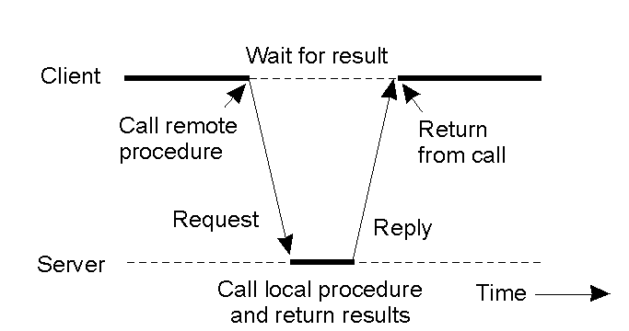
RPC between Client and Server
(synchronous)
TVS Fig 4-6 (and 4-10a)

Slide 5
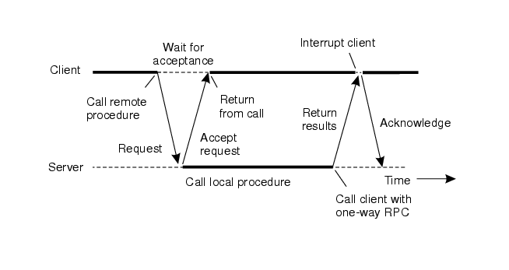
RPC between Client and Server
(asynchronous)
TVS Fig 4-11

Slide 6
CDK Figure 5.1
Middleware layers
Applications, services
RMI, RPC and events
Middleware
Request reply protocol &
External data representation
layers
(interprocess communication primitives)
Operating System (UDP & TCP)

Slide 7
Details: arguments
Client and server in different computers => cannot use addresses!
Value parameters are OK
Caller and callee need to agree on the format of messages!

Slide 8
Stubs
Instead of the code to provide the service, the client machine has a stub procedure. That:
  puts the arguments in a message
  sends that message to the server
  waits for the reply message
  unpacks the result
  returns to the application call

Slide 9
Server stub (or skeleton)
Transparency works both ways!
Code in the server to provide the service should also be “normal” – so it can be used by other code on the server to provide the same service locally ….
So the RPC message goes to a server stub – code on the server

Slide 10
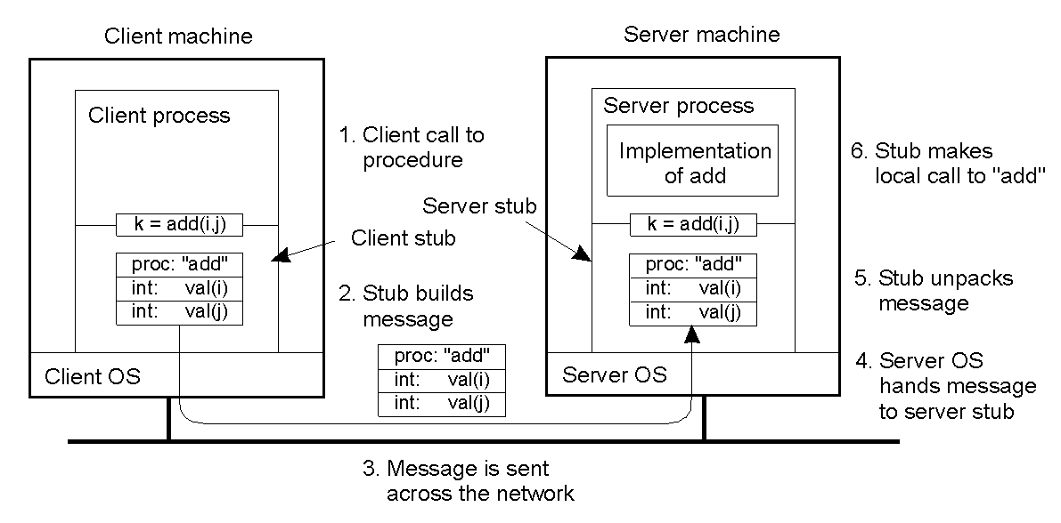
First Six Steps of RPC
TVS: Figure 4-7

Slide 11
Remaining Steps
7: add executes and returns answer to server stub
8: server stub composes reply message containing this answer
9: message is sent across the network
10: client OS passes reply to client stub
11: client stub unpacks and returns result

Slide 12
Parameter Marshalling
Packing parameters into a message is known as parameter marshalling
The inverse operation is unmarshalling
These operations need to take into account problems associated with having different machines and different languages in use in the network

Slide 13
Representational issues
Client and server can use different ways to represent values:
  Floating point formats
  Big-endian (Western style) vs little-endian (e.g., Intel)
  Character sets
  Size issues (e.g. 64 bit ints or 32 bit ints)

Slide 14
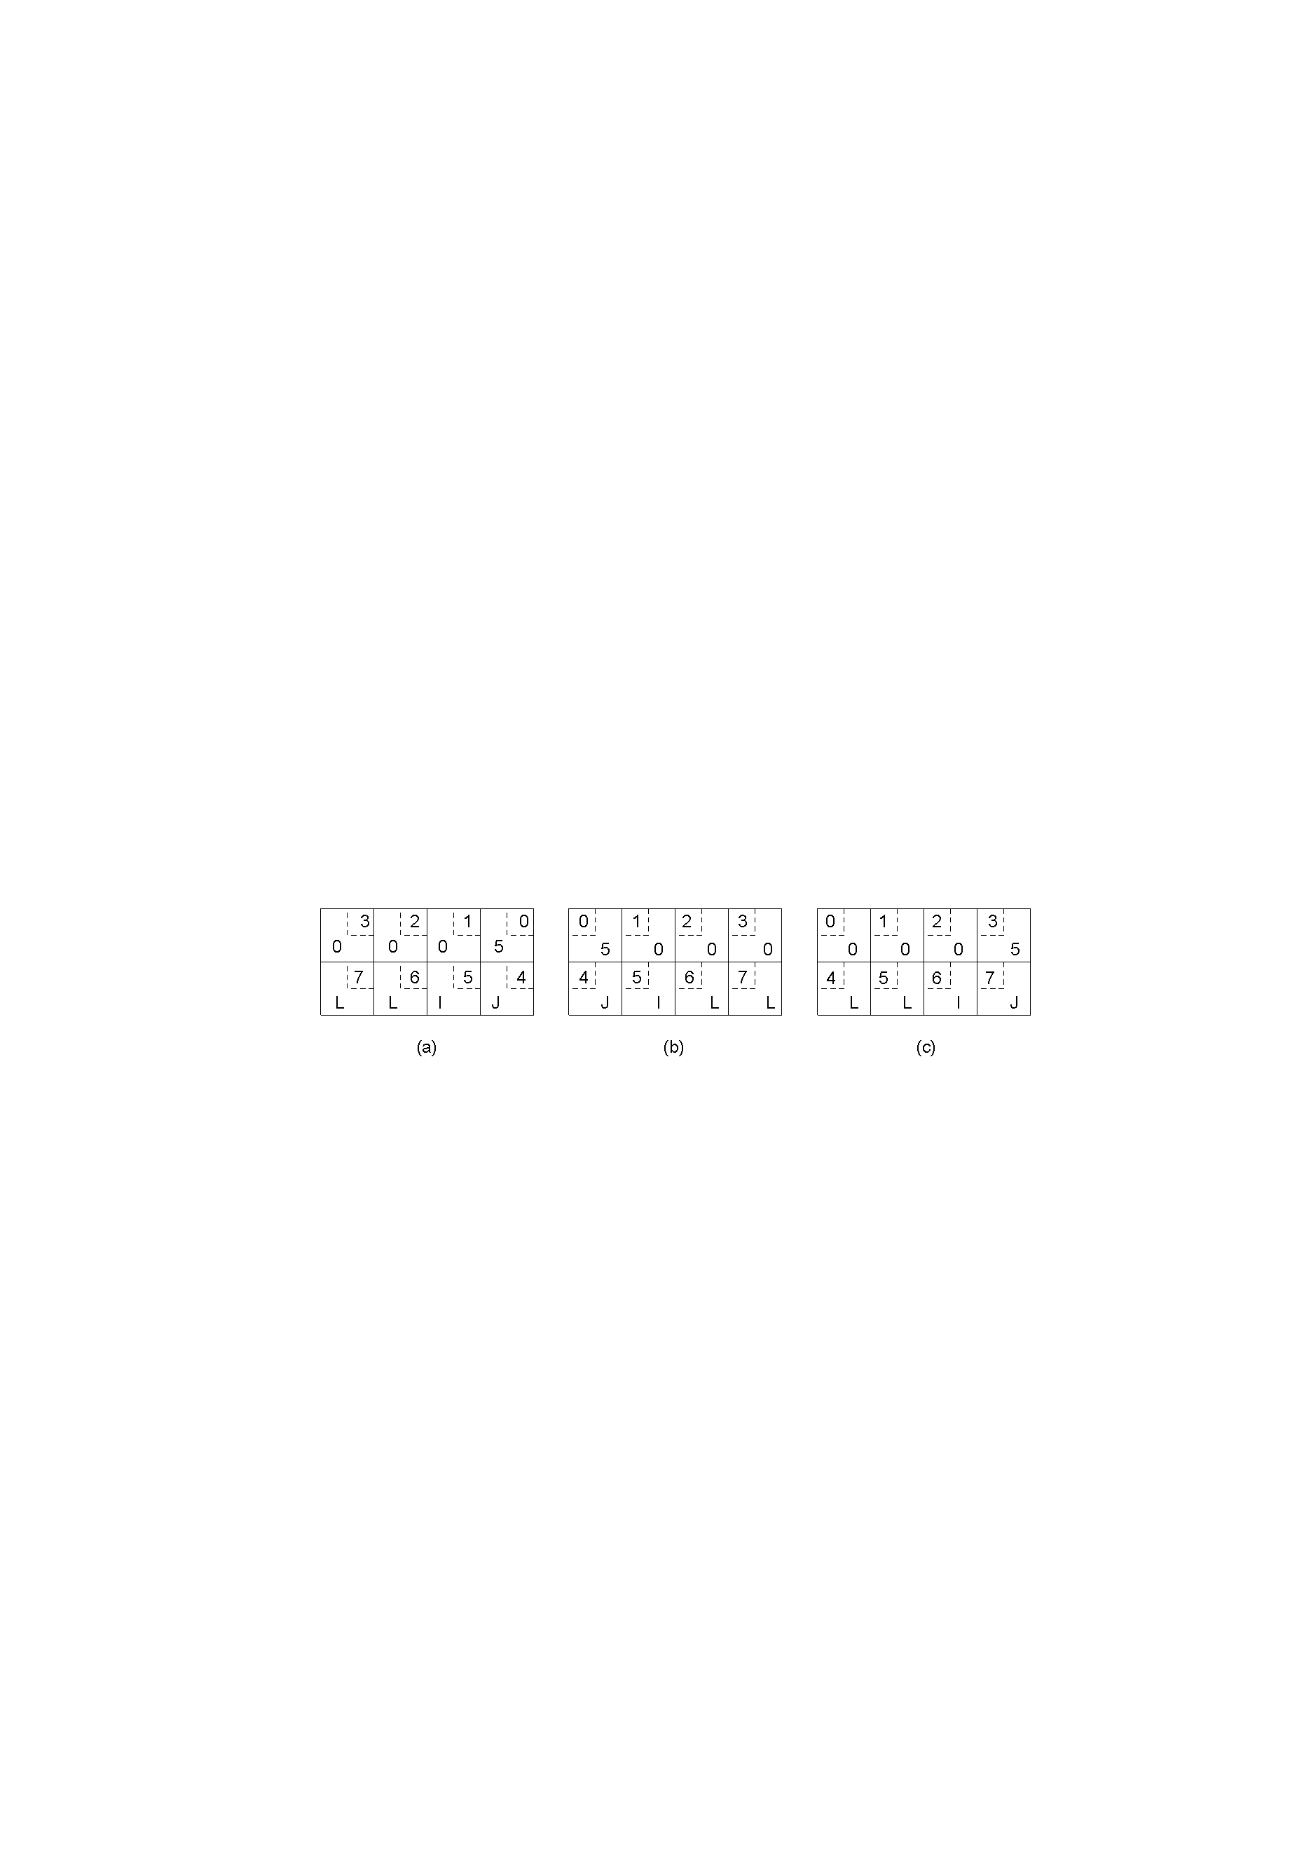
Passing Value Parameters
TVS Figure 4-8
Original message on the Pentium ([12]=1+2x256)
The message after receipt on the SPARC ([12] = 1x256+2)
The message after being inverted. The little numbers in boxes indicate the address of each byte

Slide 15
Generating Stubs
The code for the stubs can be generated once the specification of the procedure is known.
This should ideally be done in a language independent way – so that the remote service is available to many languages
Interface Definition Language (IDL)

Slide 16
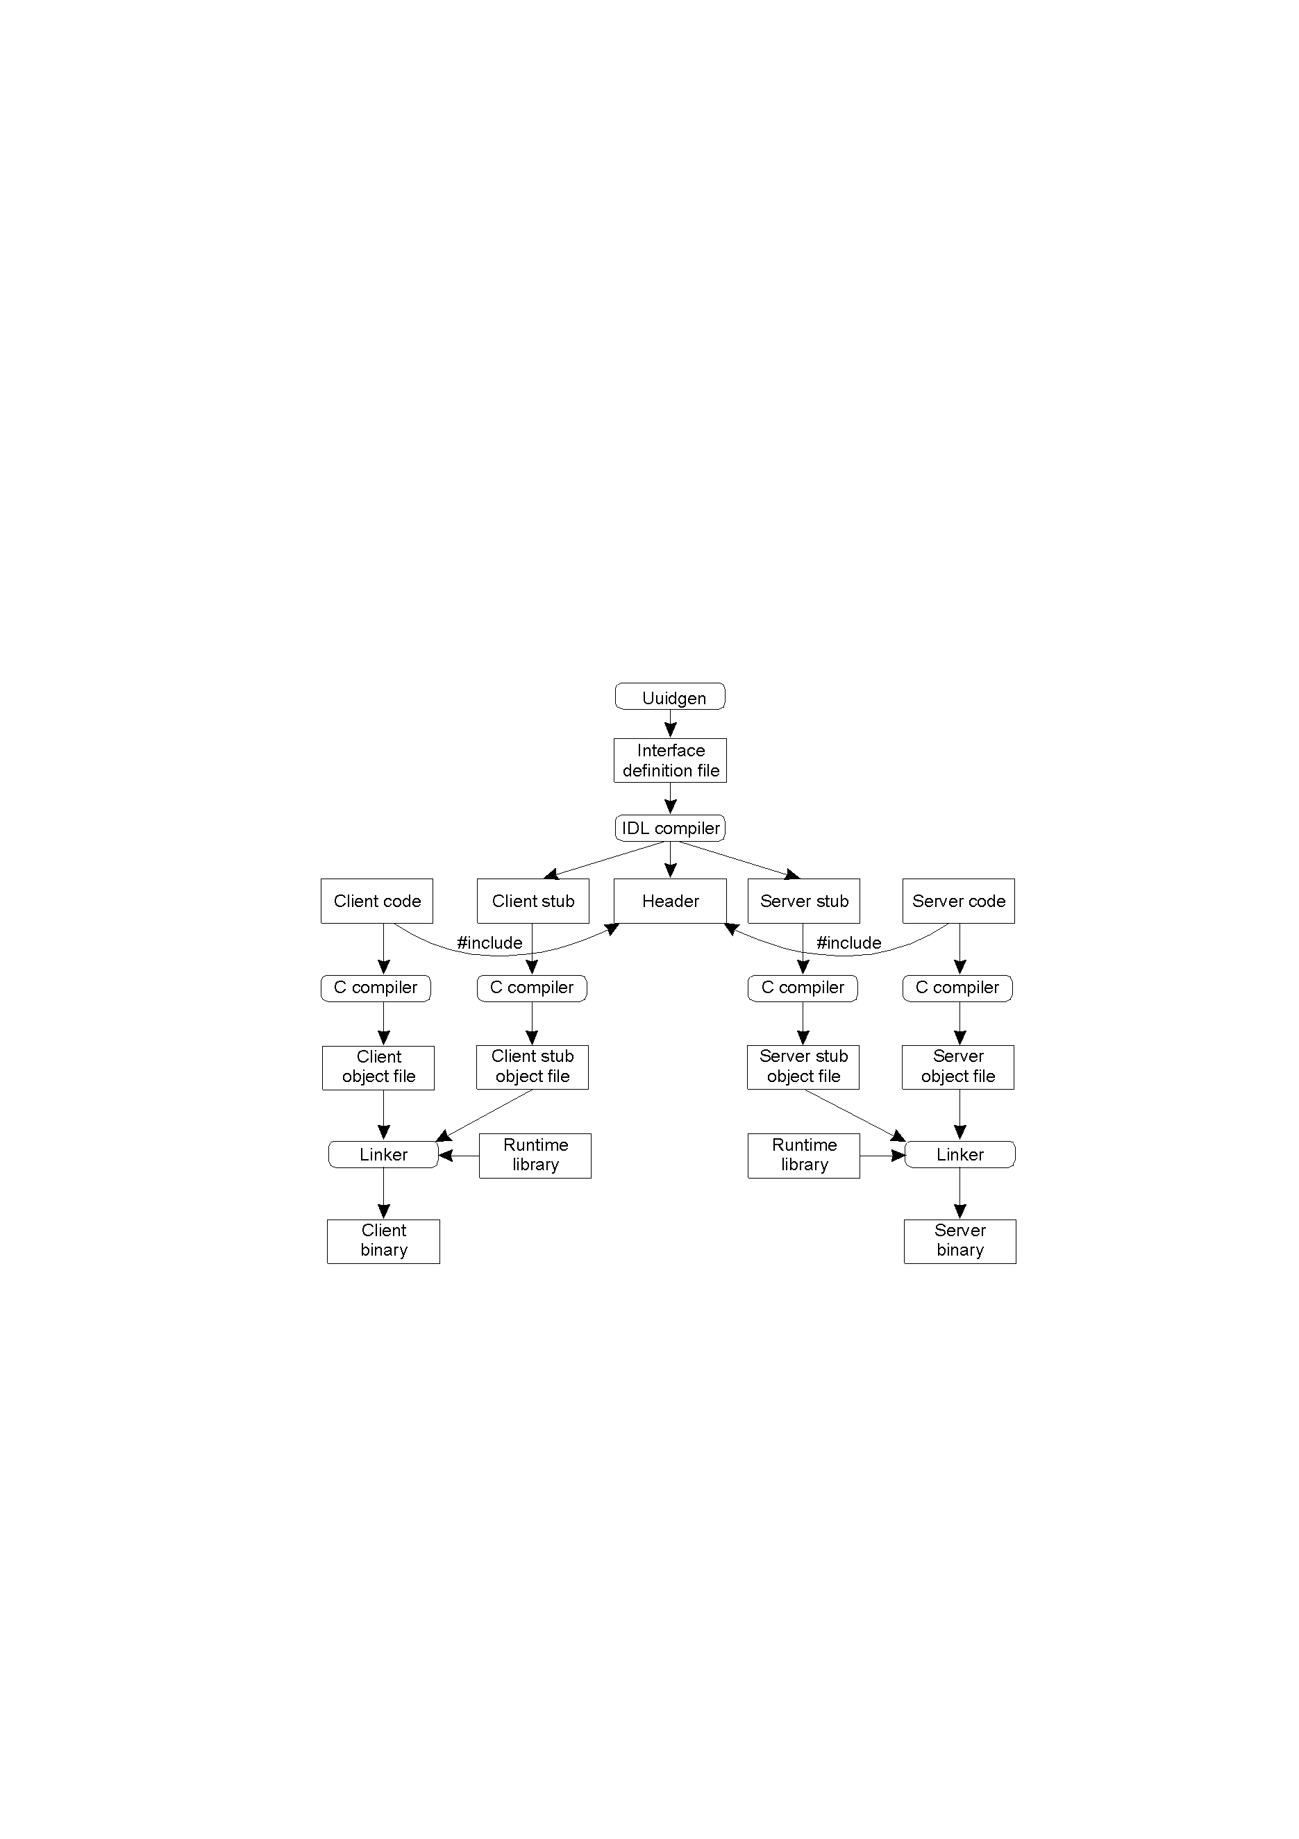
Producing a Client and a Server
TVS Figure 4-12

Slide 17
Uuidgen?
The purpose of this is to generate a unique identifier which is
  Put in the header file
  Can be used to check that the client and server stubs are compatible, i.e. to protect against errors caused by updating one and not the other

Slide 18
Features of an IDL
There are a number of IDLs
  CORBA (Common Object Request Broker Architecture)
  Sun (noted for NFS)
  DCE (Distributed Computing Environment)
Syntax of interface – but commonly with extra information (e.g. in, out, inout) about reference parameters
// Example – CORBA IDL
// In file Person.idl
struct Person {
string name;
string place;
long year;
} ;
interface PersonList {
readonly attribute string listname;
void addPerson(in Person p) ;
void getPerson(in string name,
out Person p);
long number();
};

Slide 19
Remote Method Invocation (RMI)
Java includes RMI in its API
Marshalling is simpler: Java <=> Java
It requires that objects sent as arguments or results be serializable, i.e. there is a standard external form for them. This allows arbitrarily complex structures (not possible with copy/restore parameters)

Slide 20
Remote Object References
A major difference between RMI and RPC is that there are, in RMI, references to remote objects!
In the lab, RemoteServer is an interface used to declare stub which is such a thing
The interface lists the methods which can be invoked on it
What are Remote Object References?
  (CDK 4.3.4) They must be
    system-wide
    not reused for other objects

Slide 21
RMI implementation
As with RPC, the client has a stub (called here a proxy) for each remote class instance – to marshal arguments to, and unmarshal results from, method calls
This communicates with the dispatcher for the class, which forwards to the skeleton which implements unmarshalling etc.

Slide 22
Dispatcher / Skeleton
Server has a dispatcher & a skeleton for each class of remote object
The dispatcher receives the incoming message, and uses its method info to pass it to the right method in the skeleton. (Dispatcher and proxy both work from the remote interface to get same method info!)
Skeleton implements methods of the remote interface to unmarshall arguments and invoke the corresponding method in the servant. It then marshalls the result (or any exceptions thrown) into a reply message to the proxy.

Slide 23
rmiregistry
This is how a server makes a remote object available to clients
A string is bound to the remote object, and the clients interrogate the registry using the string
The client must know the server machine name and the port the registry is on (there is a default)

Slide 24
Conclusion
When processes on different computers communicate:
  need to agree on the format of messages
  need to take into account differences of machines
Client and Server stubs are implemented
Interfaces can be specified by means of an IDL
Reading: Coulouris (ed. 4 or 5): Chapter 5 (but see Chapter 4 for “marshalling”); Tanenbaum: Section 4.2 (see 10.3.4 for RMI)

